Slide 1
Forestry Section
RI Envirothon
2023
Will Walker
Supervising Forester RIDEM
William.walker@dem.ri.gov
401.539.2356

Slide 2
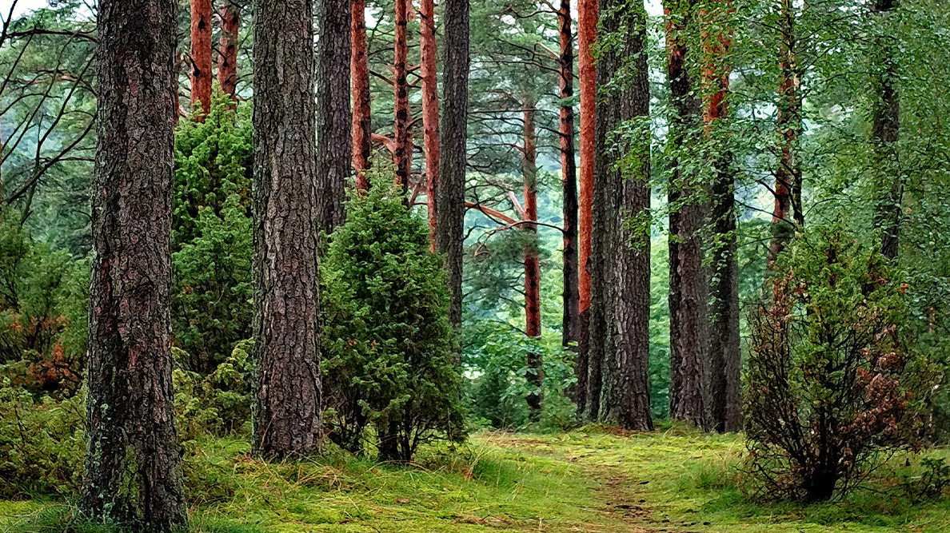
What is forestry?
Forestry is a science, an art, and a craft.
Forestry is creating, managing, conserving, and repairing forests in a sustainable manner, to meet desired goals, needs, and values for human benefit.

Slide 3
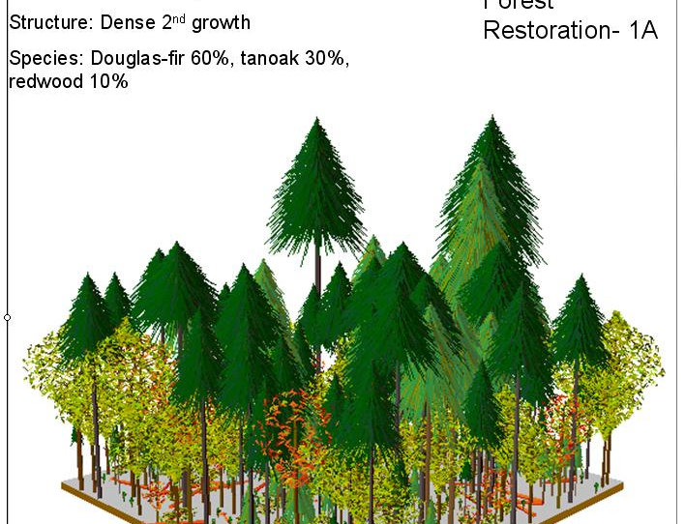
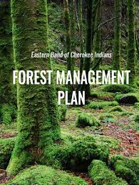
Intro to the
Forest Management Plan (FMP)
Forest management plans (FMP) can be complex or relatively simple.
It all depends on the landowners management objectives and the current conditions of the forest.

Slide 4
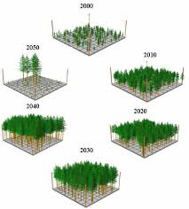
F.M.P
FMP’s typically contain the following elements:
Title / Signature page
Landowner objective statement
General property overview and history
Map set
Stand descriptions
Activity schedule
In essence, your plan is a "road map" to guide you from where you are to where you want to be.

Slide 5
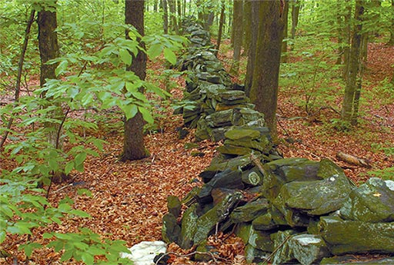
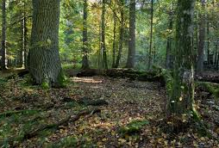
Property Overview
Consists of a general description of the property.
Attributes such as topography, watersheds, natural landmarks, major forest types and other distinctive features of the property.
Ex.) The stonewall of the eastern boundary and stand of suppressed cedar indicate past agricultural use.

Slide 6
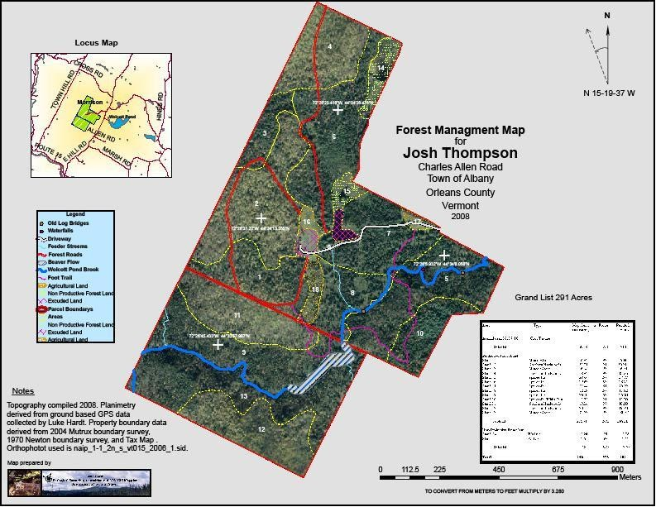
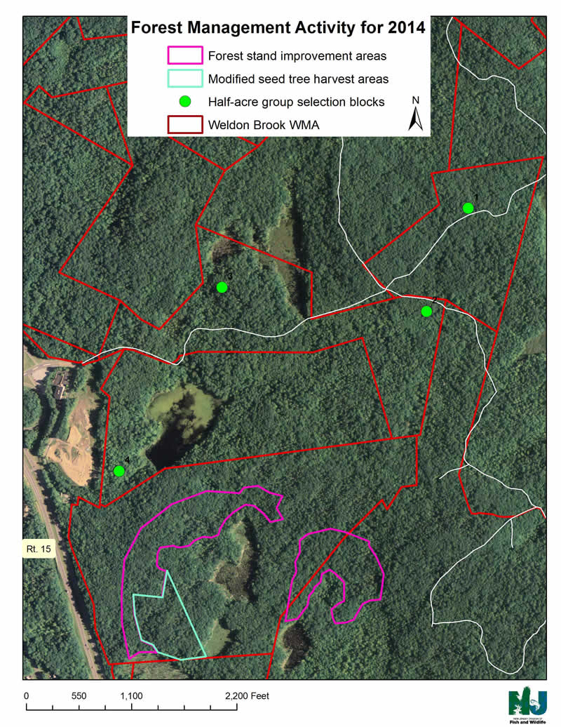
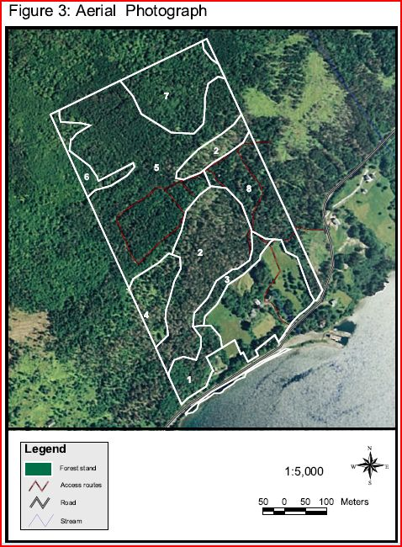
Map Set
Forest Management Plans should include at least 4 maps.
Soil map
Forest stand map
Locus map
Topography map
Other maps include wetland, aerial, and endangered species maps.

Slide 7
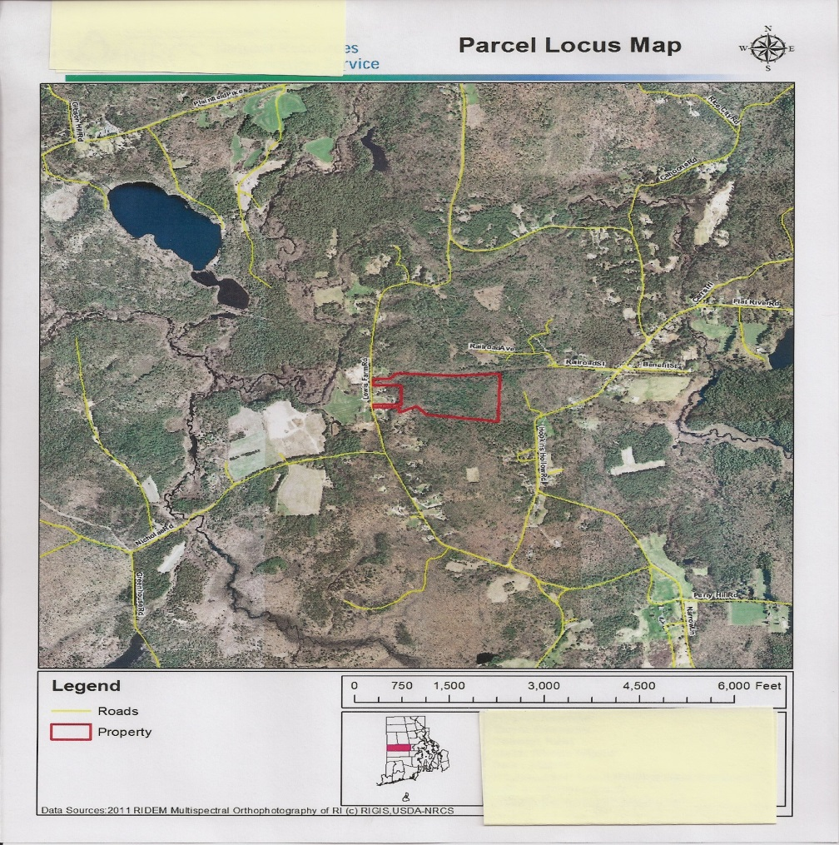
Locus Map

Slide 8
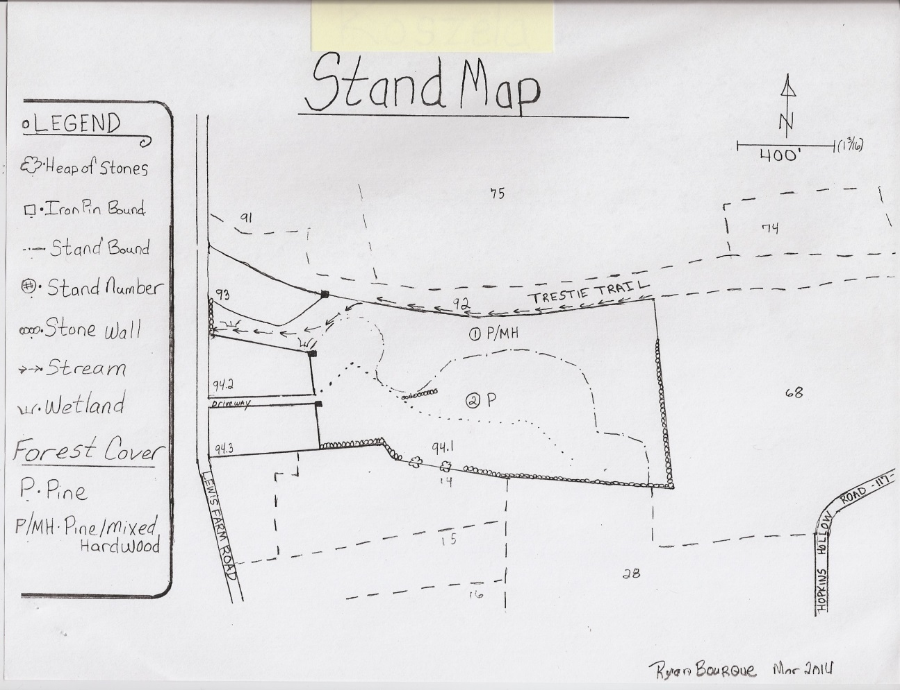
Forest type or stand map

Slide 9
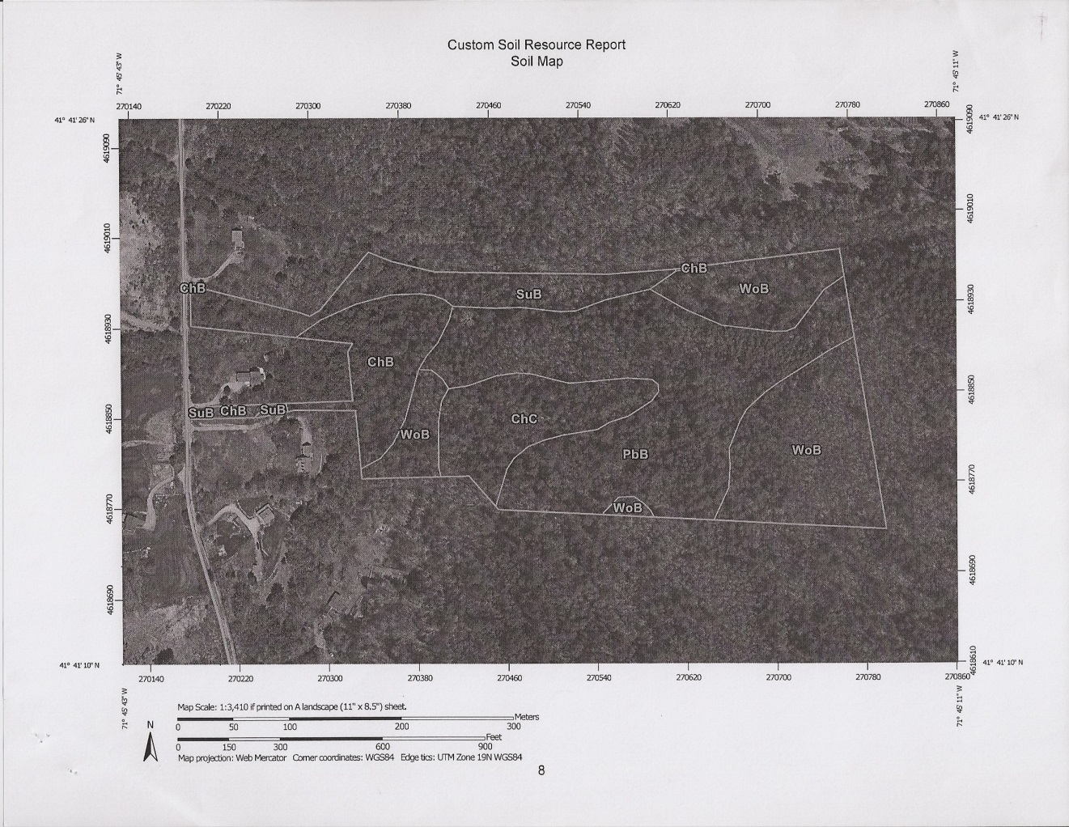
Soils map

Slide 10
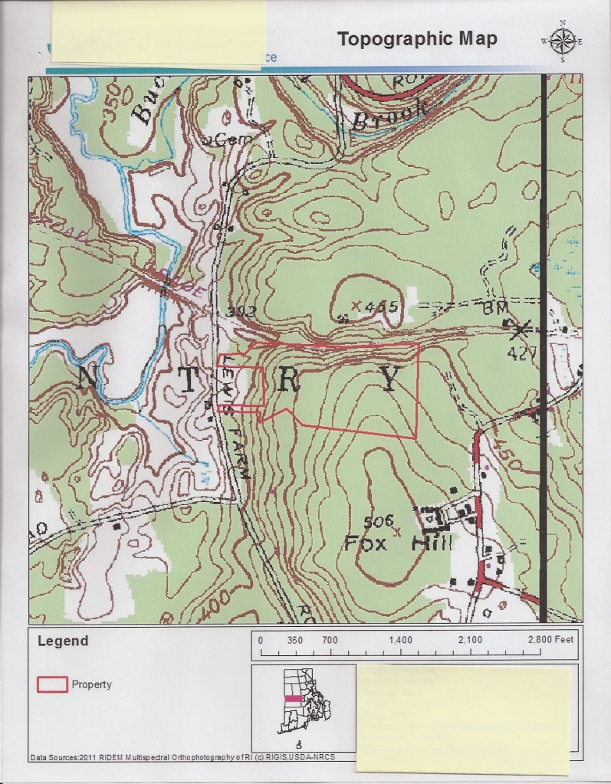
Topographic Map

Slide 11
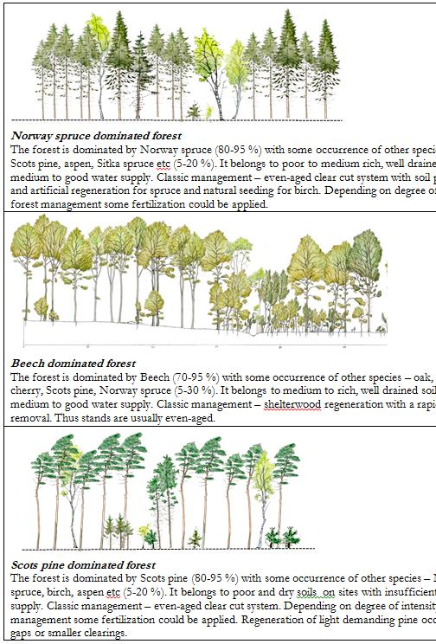
Stand Descriptions
Portion of the FMP where detail is limitless.
Meat and potatoes of the FMP.
Science.
Mathematics.
Creativity.

Slide 12
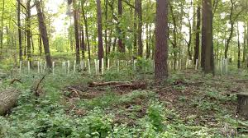
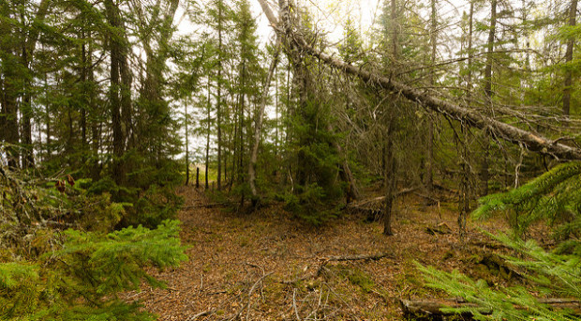
Stand Descriptions cont…
Forest stands are delineated based on age, species composition, diameter (size), health, topography, soils, the list goes on.
Each forest stand should be similar in one or more of the above attributes.

Slide 13
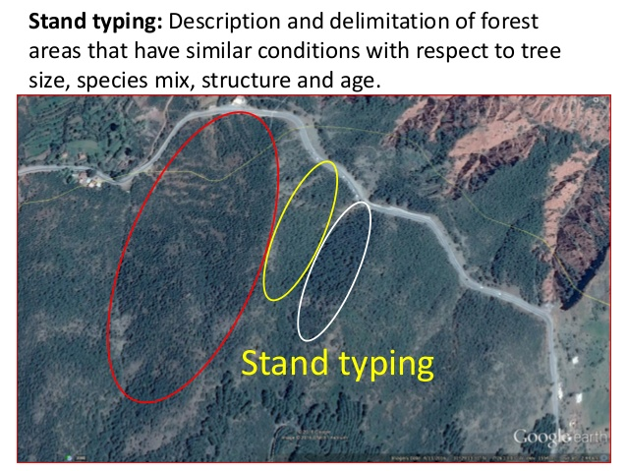
Stand Descriptions cont…
Each stand description should include;
Stand objective statement
Forest type
Understory condition
Acreage
Stocking level
Basal Area/acre
Trees per acre
Soil Type
Site index

Slide 14
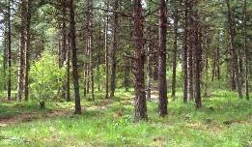
Stand Descriptions cont…
Not only numerical data required.
Narrative explaining the data and general stand overview.
Most important are the stand recommendations.
Ex.) Due to the overstocked state of this stand, conduct some thinning. Remove poorly formed stems that have no future timber value, while releasing more desirable trees. Overall forest health will improve as a result of this thinning.

Slide 15
So what’s the takeaway??
Title / Signature page
Landowner objective statement
General property overview and history
Map set
Stand descriptions
Activity schedule

Slide 16

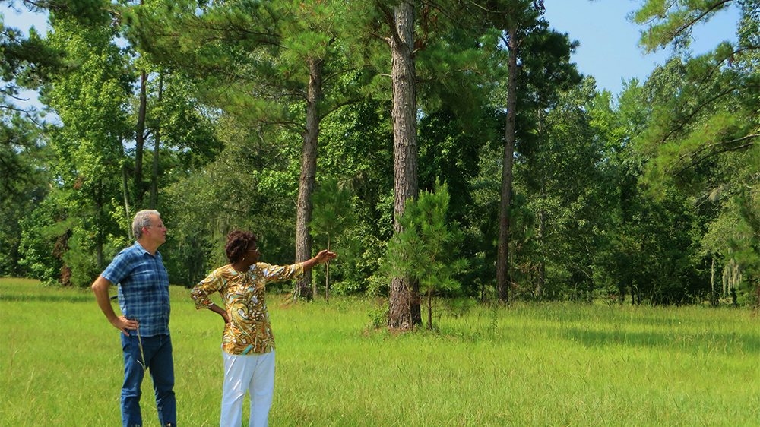
Most Importantly
Base recommendations on achieving the landowner’s Goals/Objectives.

Slide 17
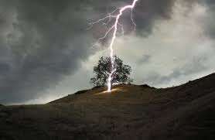
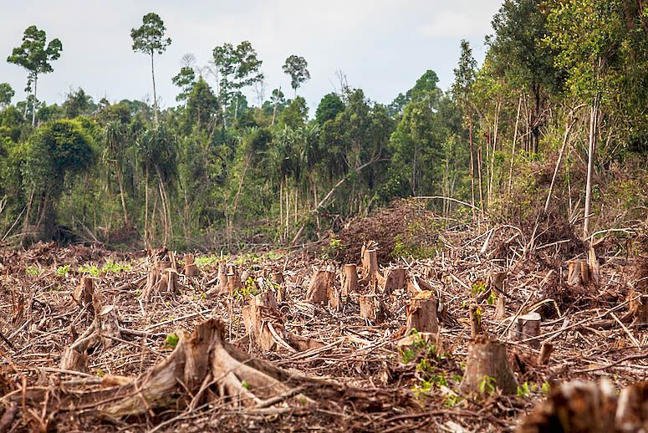
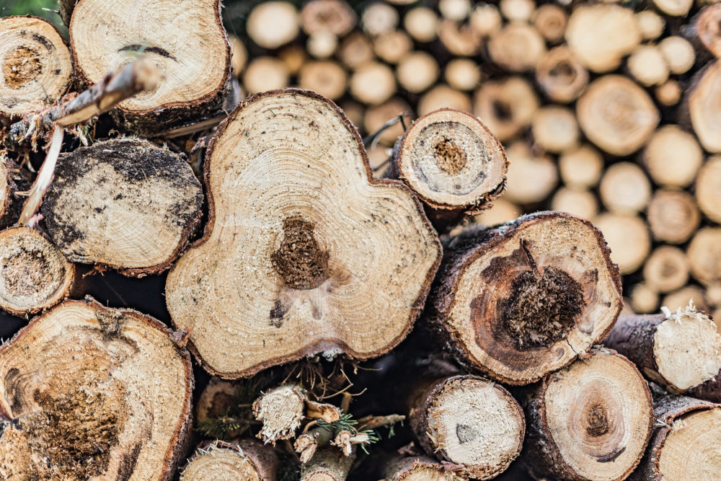
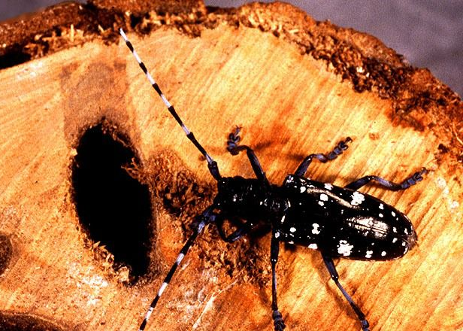
Tree Damaging Agents
Weather
Human Impact
Disease
Insects

Slide 18
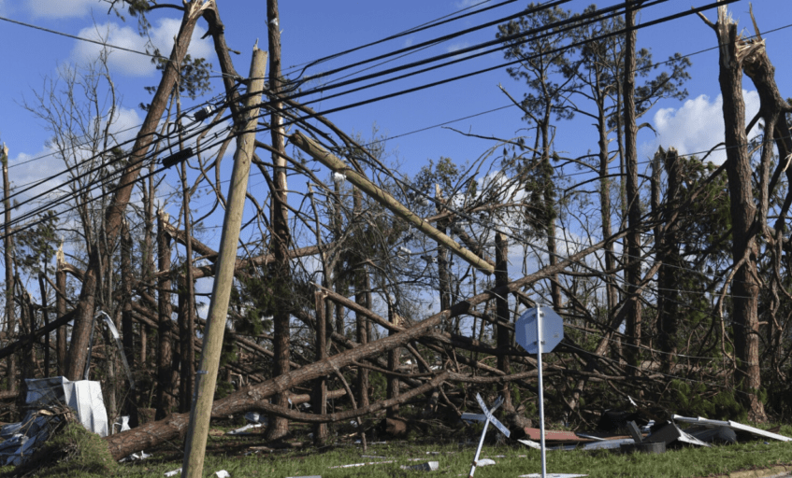
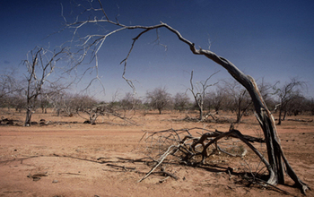
Weather
Drought
Strong winds
Flooding
Lightning
Natural Disasters
  Hurricanes
  Tropical storms
  Tornadoes

Slide 19
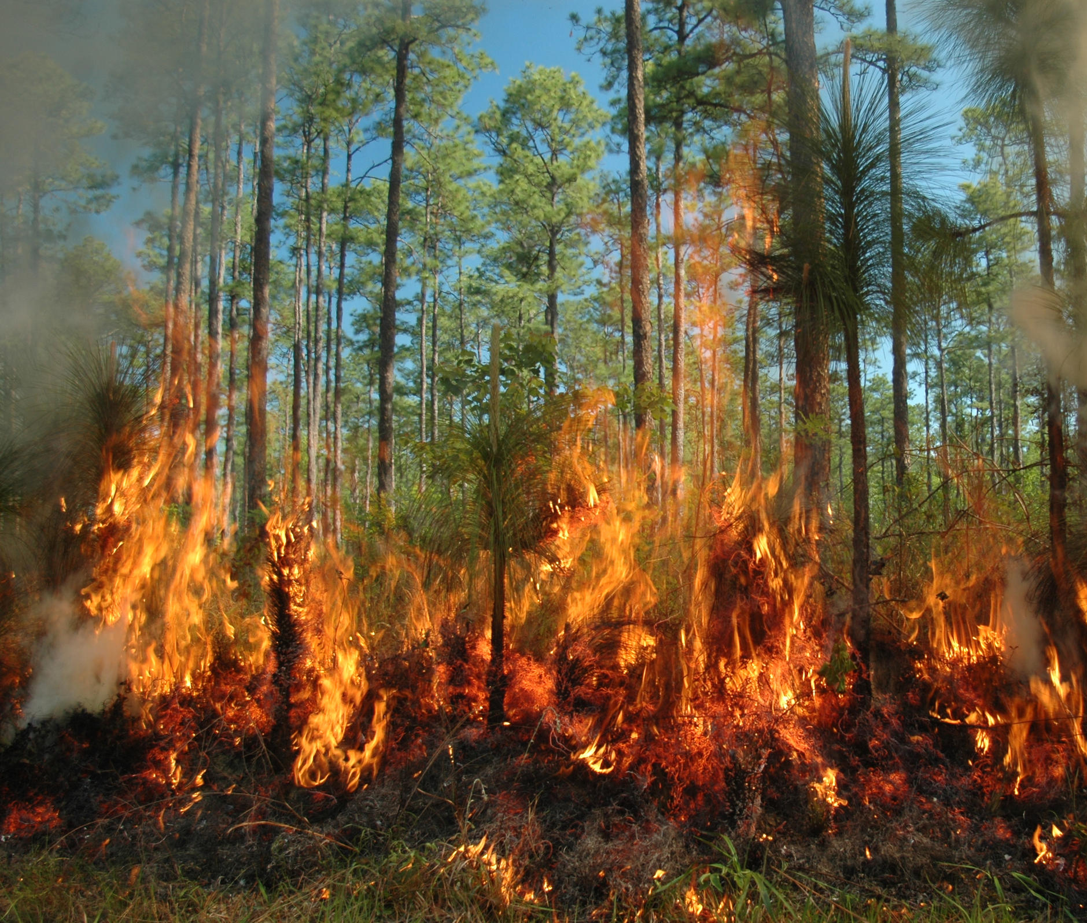
Human Impact
Logging
Harvesting
Wildfires
Recreational
Development

Slide 20
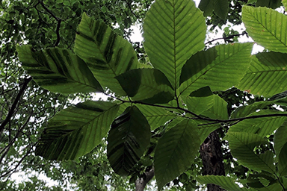
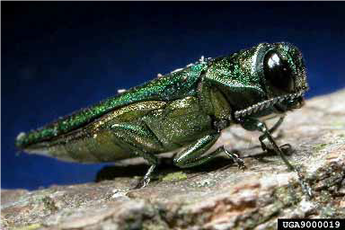
Insects and Diseases
Eastern longhorn beetle
Emerald ash borer
Gypsy moth
Hemlock wooly adelgid
Aphids
Fungi
Beech leaf disease (BLD)
Beech bark disease
Sudden oak death
White pine needle damage

Slide 21

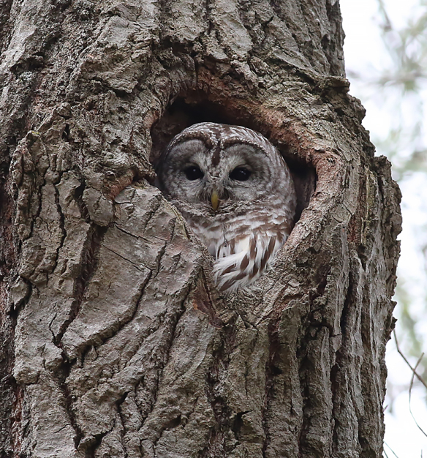
Tree Benefits
Shade
Oxygen
Wood products
Erosion prevention
Wildlife cover and Habitat
Carbon sequestration

Slide 23
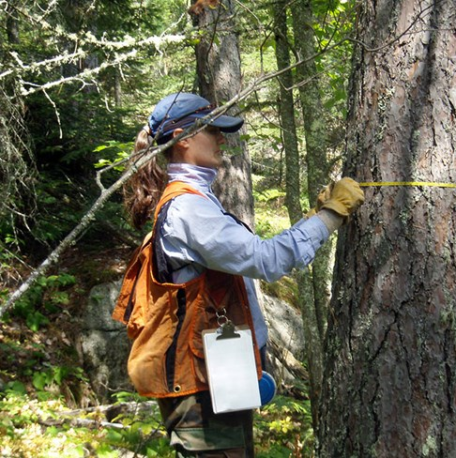
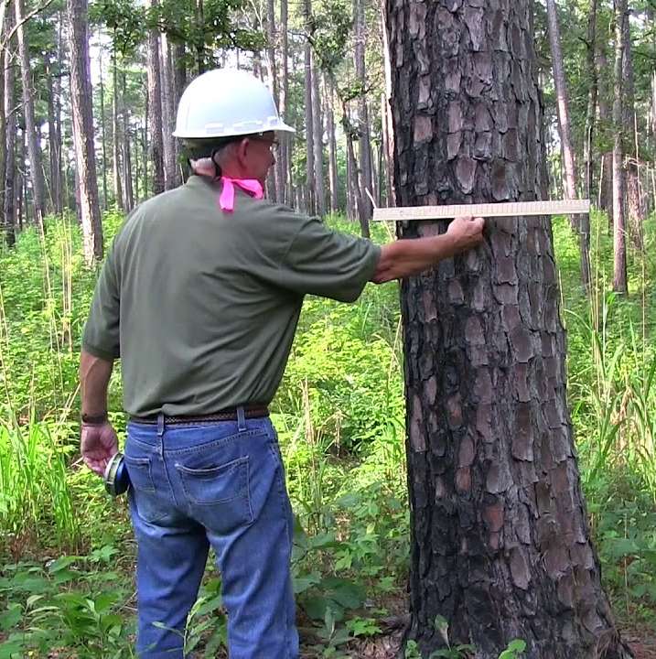
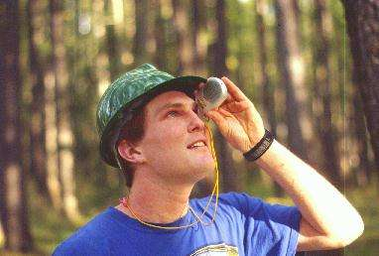
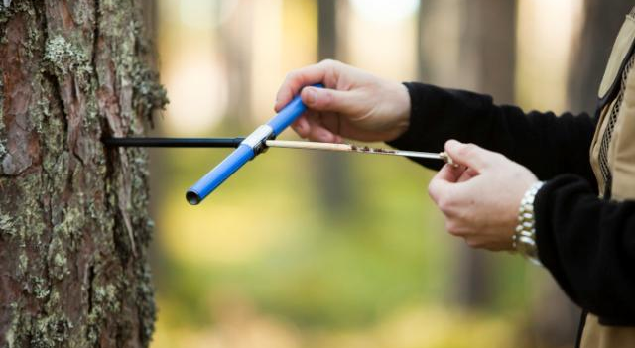
Tools of the trade
Biltmore Stick
Clinometer
Diameter Tape
Increment Borer

Slide 24
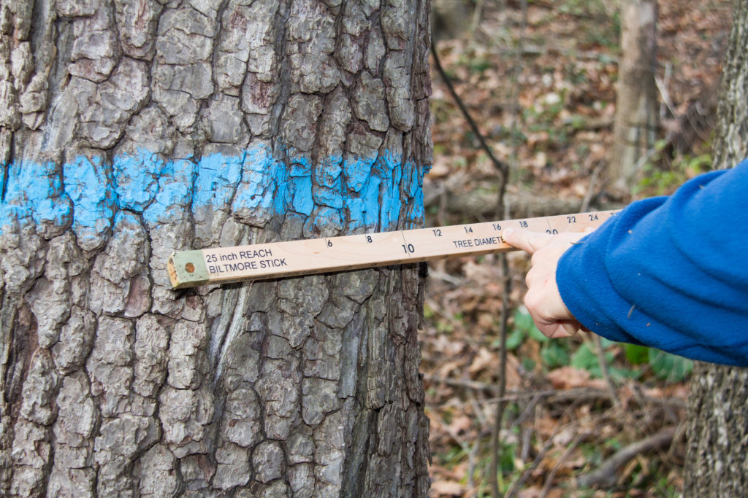
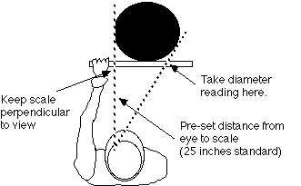
Biltmore stick

Slide 25
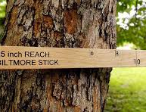
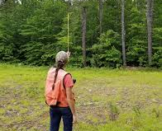
Biltmore stick
Measure on uphill side of tree ay 4.5 feet above ground (DBH) Diam. At Breast Height
Also used to measure tree height, stand 1 Chain (66 Feet) away. This reading is taken in logs (16 foot increments)

Slide 26
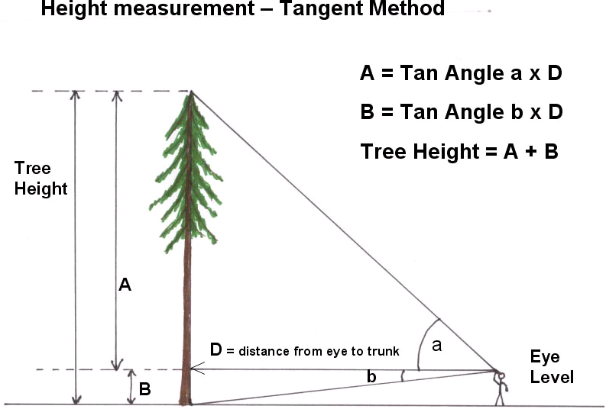
Clinometer
If A = 62 and B = 4
D= 100 Feet
Tree Height would = ???

Slide 28
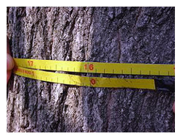
Diameter Tape
Slower but more precise than Biltmore stick

Slide 29
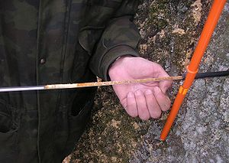
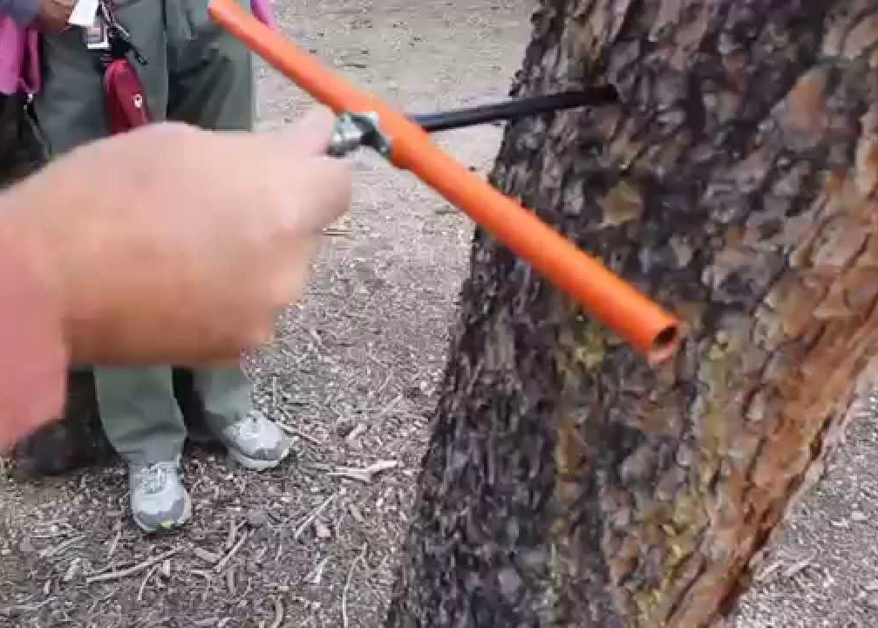
Increment Borer

Slide 30
Special Topic
Climate Change
Trees absorb Co2 from the atmosphere.
Through photosynthesis the Co2 is converted into carbon.
Forests are one of the largest carbon sinks on planet earth.
Faster growing, healthier trees absorb more Co2 from the atmosphere.

Slide 31
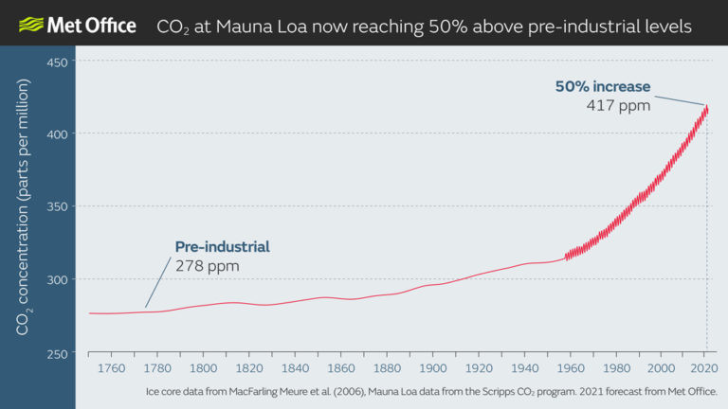

Slide 32
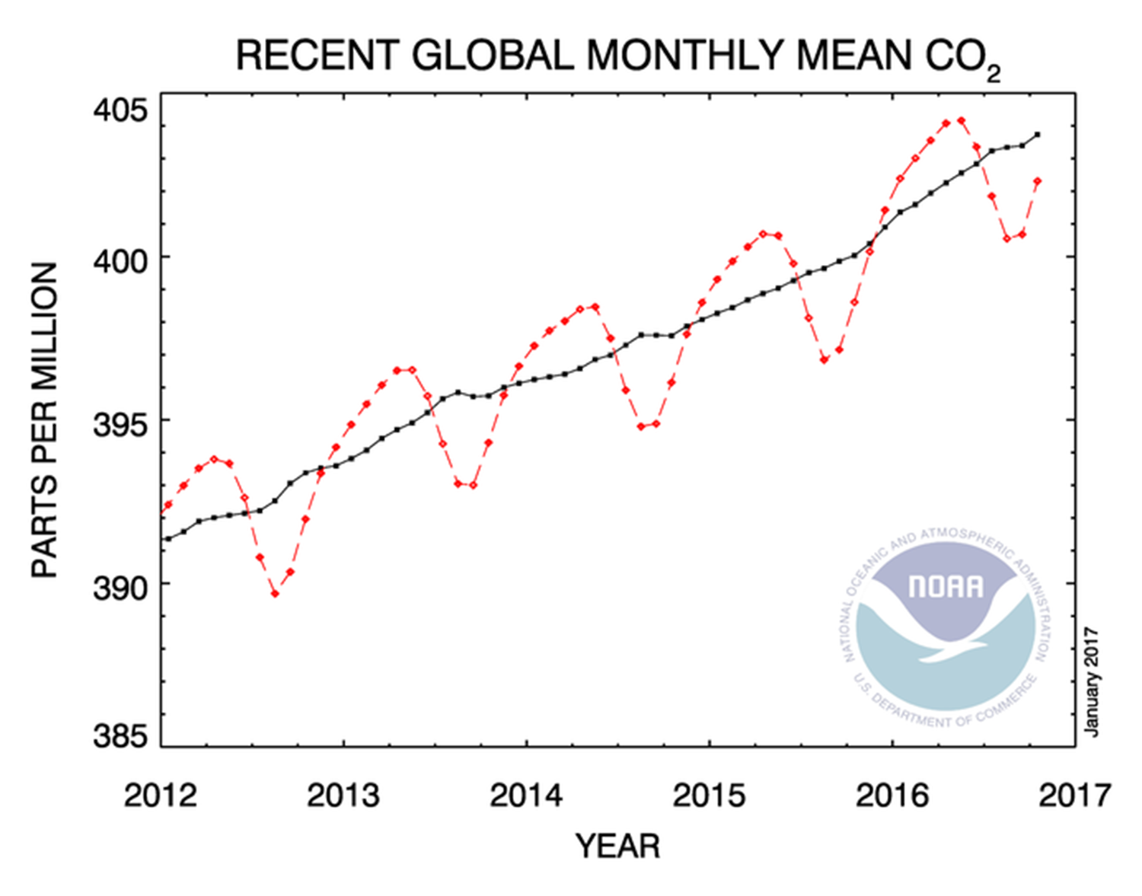
Co2 levels decrease in the atmosphere when the northern hemisphere is in it’s growing season (spring, summer).
Notice how the red dotted line increases during the winter when trees are not absorbing carbon from the atmosphere.

Slide 33
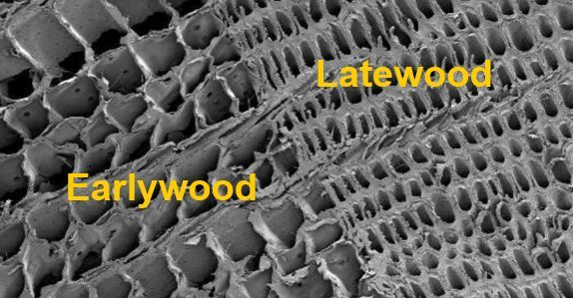
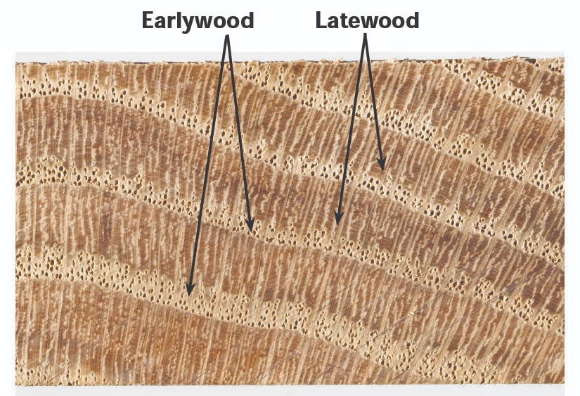
Early wood is developed in the spring when trees leaf out and the growing season begins
Late wood develops during the summer and into the fall before the growing season ends. This is carbon sequestration right before our eyes.

Slide 34
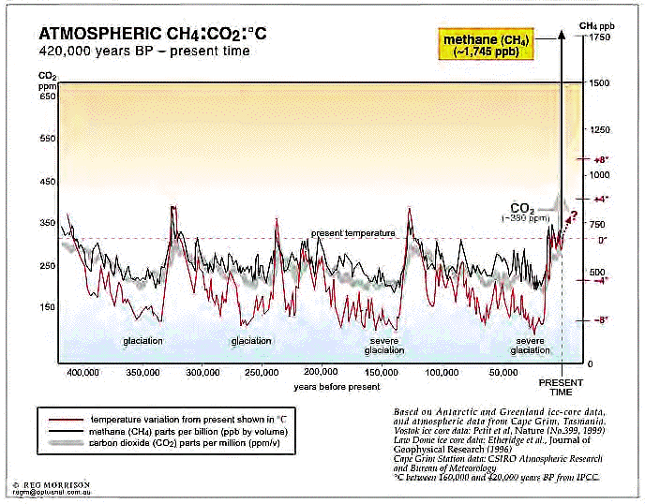
Malankovich cycles have been closely associated with the atmospheres Co2 levels and glaciations (ice ages)
Once Co2 levels reach 400 ppm the earth begins it’s trend into the next ice age.
Anthropogenic climate change is speeding up that process. The use of fossil fuels has accelerated the atmospheric carbon levels.

Slide 35
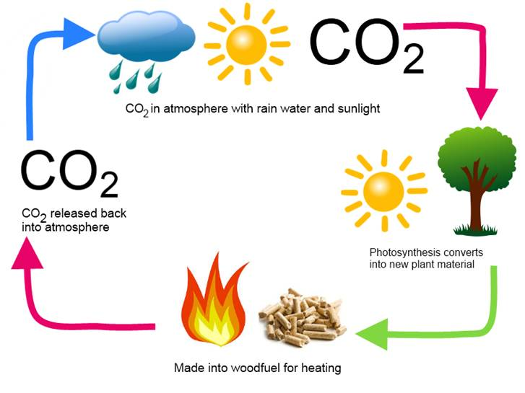
Using wood for fuel to heat our homes is carbon neutral whereas using fossil fuels is not.

Slide 36
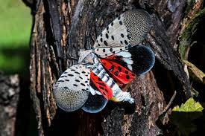
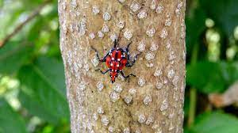
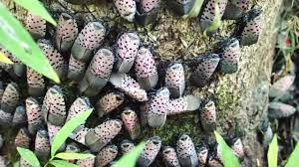
NEW INVASIVE https://www.aphis.usda.gov/publications/plant_health/alert-spotted-lanternfly.pdf
Spotted Lanternfly

Slide 40





Questions?

